Slide 1
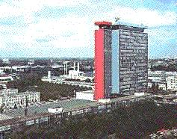
Transport Triggered Architectures used for Embedded Systems
International Symposium on
NEW TRENDS IN
COMPUTER ARCHITECTURE
Gent, Belgium
December 16, 1999
Henk Corporaal
EE department
Delft Univ. of Technology
h.corporaal@et.tudelft.nl
http://cs.et.tudelft.nl

Slide 2
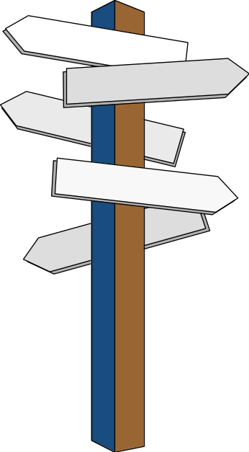
Topics
MOVE project goals
Architecture spectrum of solutions
From VLIW to TTA
Code generation for TTAs
Mapping applications to processors
Achievements
TTA related research

Slide 3
MOVE project goals
Remove bottlenecks of current ILP processors
Tools for quick processor and system design; offer expertise in a package
Application driven design process
Exploit ILP to its limits (but not further !!)
Replace hardware complexity with software complexity as far as possible
Extreme functional flexibility
Scalable solutions
Orthogonal concept (combine with SIMD, MIMD, FPGA function units, ... )

Slide 4
Architecture design spectrum
Four dimensional architecture design space: I,O,D,S
S = Σ freq (op) lt(op)
Data/operation ‘D’
SIMD
CISC
(1,1,1,1)
Superscalar
Dataflow
RISC
Instructions/cycle ‘I’
Operations/instruction ‘O’
Superpipelined
VLIW
Superpipelining degree ‘S’
(MOVE design space)

Slide 5
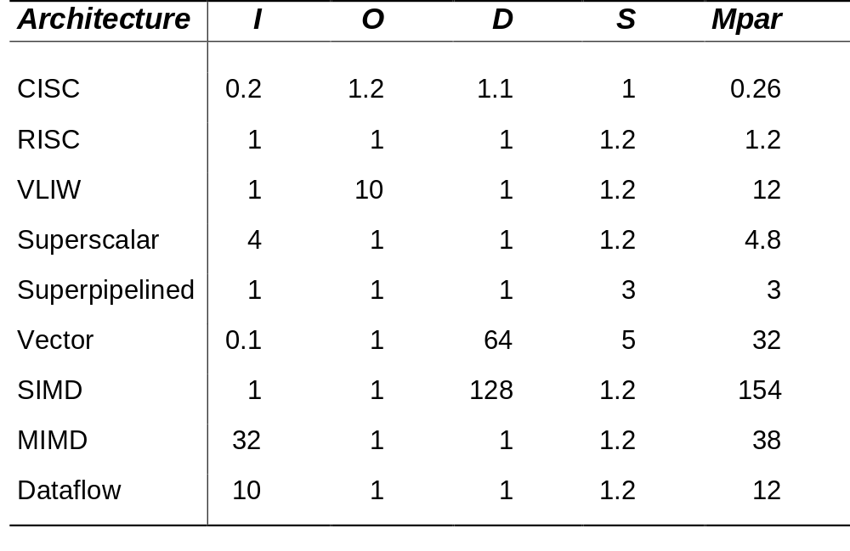
Architecture design spectrum
Mpar is the amount of parallelism to be exploited by the compiler / application !

Slide 6
Architecture design spectrum
Which choice: I,O,D,or S ? A few remarks:
I: instructions / cycle
  Superscalar / dataflow: limited scaling due to complexity
  MIMD: do it yourself
O: operations / instruction
  VLIW: good choice if binary compatibility not an issue
  Speedup for all types of applications

Slide 7
Architecture design spectrum
D: data/operation
  SIMD / Vector: application has to offer this type of parallelism
  may be good choice for multimedia
S: pipelining degree
  Superpipelined: cheap solution
  however, operation latencies may become dominant
  unused delay slots increase
MOVE project initially concentrates on O and S

Slide 8
From VLIW to TTA
VLIW
Scaling problems
  number of ports on register file
  bypass complexity
Flexibility problems
  can we plug in arbitrary functionality ?
TTA: reverse the programming paradigm
  template
  characteristics

Slide 9
From VLIW to TTA
General organization of a VLIW
CPU
FU-1
FU-2
Instruction fetch unit
Instruction decode unit
Instruction memory
FU-3
Bypassing network
Data memory
Register file
FU-4
FU-5

Slide 10
From VLIW to TTA
Strong points of VLIW:
  Scalable (add more FUs)
  Flexible (an FU can be almost anything)
Weak points:
With N FUs:
  Bypassing complexity: O(N²)
  Register file complexity: O(N)
  Register file size: O(N²)
Register file design restricts FU flexibility
Solution: mirror programming paradigm

Slide 11
Transport Triggered Architecture
General organization of a TTA
CPU
FU-1
FU-2
FU-3
Instruction fetch unit
Instruction decode unit
Bypassing network
Instruction memory
FU-4
Data memory
FU-5
Register file

Slide 12
TTA structure; datapath details
load/store
unit
load/store
unit
integer
ALU
integer
ALU
float
ALU
Socket
integer
RF
float
RF
boolean
RF
instruct.
unit
immediate
unit

Slide 13
TTA characteristics
Hardware
Modular: Lego play tool generator
Very flexible and scalable
  easy inclusion of Special Function Units (SFUs)
Low complexity
  50% reduction on # register ports
  reduced bypass complexity (no associative matching)
  up to 80 % reduction in bypass connectivity
  trivial decoding
  reduced register pressure

Slide 14
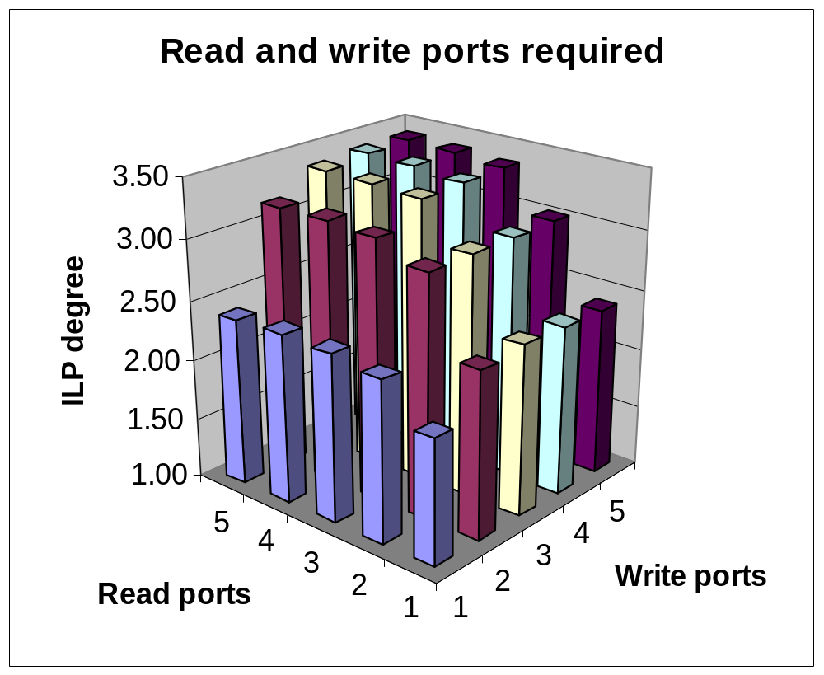
Register pressure

Slide 15
TTA characteristics
Software
  A traditional Operation-triggered instruction:
  mul r1, r2, r3
  A Transport-triggered instruction:
  r3 → mul.o, r2→ mul.t, mul.r → r1
Extra scheduling optimizations
However: More difficult to schedule !

Slide 16
Code generation trajectory
Frontend:
GCC or SUIF
(adapted)
Application (C)
Compiler frontend
Architecture description
Sequential code
Sequential simulation
Input/Output
Compiler backend
Profiling data
Parallel code
Parallel simulation
Input/Output

Slide 17
TTA compiler characteristics
Handles all ANSI C programs
Region scheduling scope with speculative execution
Using profiling
Software pipelining
Predicated execution (e.g. for stores)
Multiple register files
Integrated register allocation and scheduling
Fully parametric

Slide 18
Code generation for TTAs
TTA specific optimizations
  common operand elimination
  software bypassing
  dead result move elimination
  scheduling freedom of T, O and R
Our scheduler (compiler backend) exploits these advantages

Slide 19
TTA specific optimizations
Bypassing can eliminate the need of RF accesses
Example: r1 -> add.o, r2 -> add.t;
add.r -> r3;
r3 -> sub.o, r4 -> sub.t
sub.r -> r5;
Translates into:
r1 -> add.o, r2 -> add.t;
add.r -> sub.o, r4 -> sub.t;
sub.r -> r5;

Slide 20
Mapping applications to processors
We have described a
Templated architecture
Parametric compiler exploiting specifics of the template
Problem:
How to tune a processor architecture for a certain application domain?

Slide 21
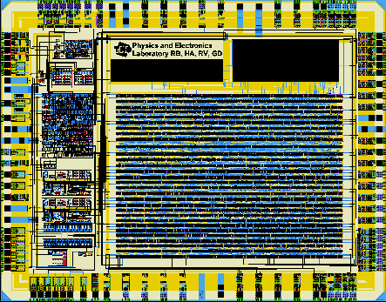
Mapping applications to processors
User
intercation
Optimizer
x
x
Pareto curve
(solution space)
x
exec. time
x
x
feedback
Architecture
parameters
feedback
x
x
x
x
x
x
x
x
x
x
x
x
x
x
x
cost
Parametric compiler
Hardware generator
Move framework
Parallel
object
code
chip

Slide 22
Achievements within the MOVE project
Transport Triggered Architecture (TTA) template
  lego playbox toolkit
Design framework almost operational
  you may add your own ‘strange’ function units (no restrictions)
Several chips have been designed by TUD and Industry; their applications include
  Intelligent datalogger
  Video image enhancement (video stretcher)
  MPEG2 decoder
  Wireless communication

Slide 23
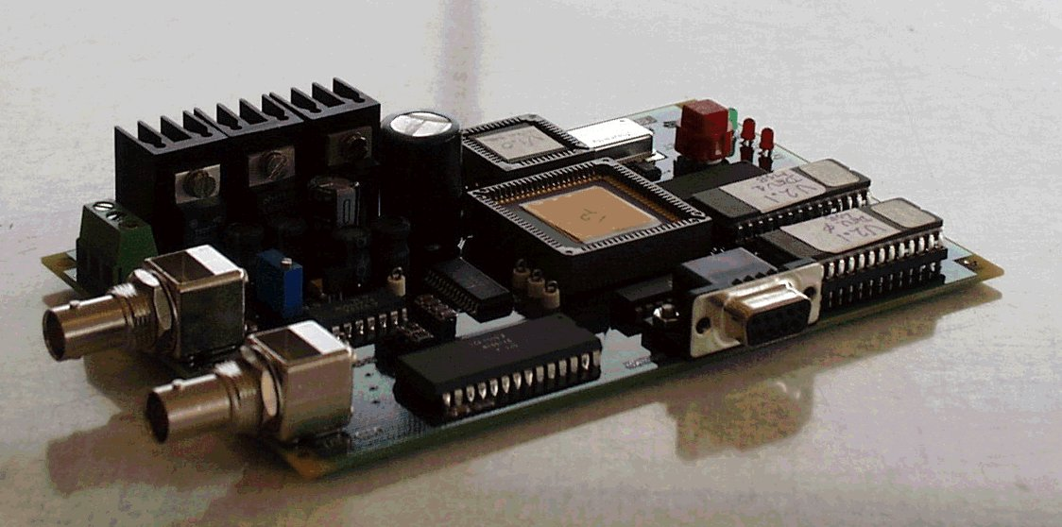
Video stretcher board containing TTA

Slide 24
Intelligent datalogger
mixed signal
special FUs
on-chip RAM
and ROM
operates stand
alone
core generated
automatically
C compiler

Slide 25
TTA related research
RoD: registers on demand scheduling
SFUs: pattern detection
CTT: code transformation tool
Multiprocessor single chip embedded systems
Global program optimizations
Automatic fixed point code generation
ReMove

Slide 26
RoD: Register on Demand scheduling

Slide 27
Phase ordering problem: scheduling ↔ allocation
Early register assignment
  Introduces false dependencies
  Bypassing information not available
Late register assignment
  Span of live ranges likely to increase which leads to more spill code
  Spill/reload code inserted after scheduling which requires an extra scheduling step
Integrated with the instruction scheduler: RoD
  More complex

Slide 28
RoD
4 -> add.o, x -> add.t, add.r-> y;
r0 -> sub.o, y -> sub.t, sub.r -> z;
Schedule
RRTs
step 1.
step 2.
step 3.
step 4.
step 5.
4 -> add.o r1-> add.t
4 -> add.o r1 -> add.t
add.r -> r1
4-> add.o r1 -> add.t
add.r -> sub.t
4-> add.o r1 -> add.t
add.r -> sub.t r0 -> sub.o
sub.r -> r7
r0
r0
r0
r0, r1
r0
r0
r0
r7

Slide 29
Spilling
Occurs when the number of simultaneously live variables exceeds the number of registers
Contents of variables are stored in memory
The impact on the performance due to the insertion of extra code must be as small as possible

Slide 30
Spilling
def r1
store r1
def x
def y
def r1
use x
use y
use r1
load r1
use r1

Slide 31
Spilling
Operation to schedule:
x -> sub.o, r1 -> sub.t;
sub.r -> r3;
Code after spill code insertion: Bypassed code:
4 -> add.o, fp -> add.t; 4 -> add.o, fp -> add .o;
add.r -> z; add.r -> ld.t;
z -> ld.t; ld.r -> sub.o, r1 -> sub.t;
ld.r -> x; sub.r -> r3;
x -> sub.o, r1 -> sub.t;
sub.r -> r3;

Slide 32
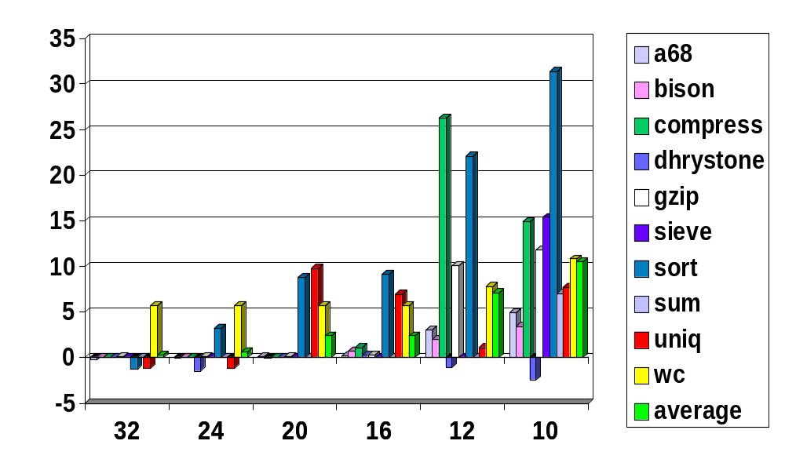
RoD compared with early assignment
Speedup of RoD[%]
Number of registers

Slide 33
RoD compared with early assignment
Impact of decreasing number of registers
24
20
early assignment
RoD
16
cycle count increase[%]
12
8
4
0
12
16
20
24
28
32
Number of registers

Slide 34
Special Functionality: SFUs

Slide 35

Mapping applications to processors
SFUs may help !
Which one do I need ?
Tradeoff between costs and performance
SFU granularity ?
Coarse grain: do it yourself (profiling helps)
Move framework supports this
Fine grain: tooling needed

Slide 36
SFUs: fine grain patterns
Why using fine grain SFUs:
  code size reduction
  register file #ports reduction
  could be cheaper and/or faster
  transport reduction
  power reduction (avoid charging non-local wires)
Which patterns do need support?
Detection of recurring operation patterns needed

Slide 37
SFUs: Pattern identification
Method:
Trace analysis
Built DDG
Create pattern library on demand
Fusing partial matches into complete matches

Slide 38
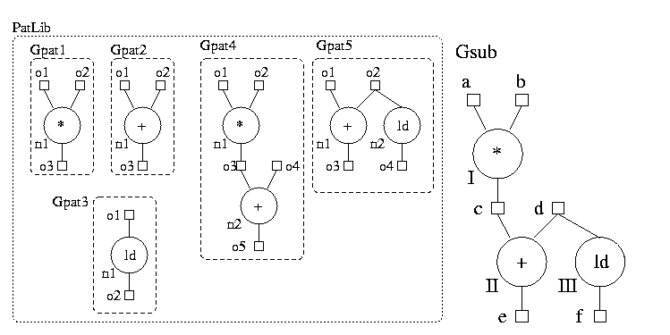
SFUs: fine grain patterns
General pattern & subject graph
  multi-output
  non-tree
  operand and operation nodes

Slide 39
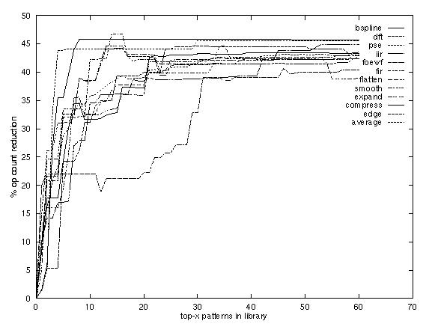
SFUs: covering results

Slide 40
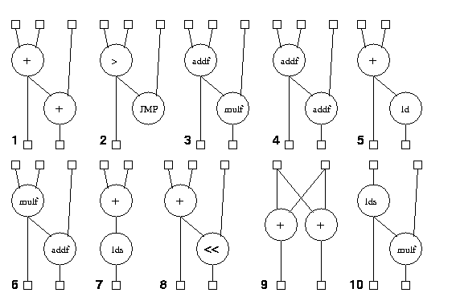
SFUs: top-10 patterns (2 ops)

Slide 41
SFUs: conclusions
Most patterns are: multi-output and not tree like
Patterns 1, 4, 6 and 8 have implementation advantages
20 additional 2-node patterns give 40% reduction (in operation count)
Group operations into classes for even better results
Now: scheduling for these patterns? How?

Slide 42
Source-to-Source transformations

Slide 43
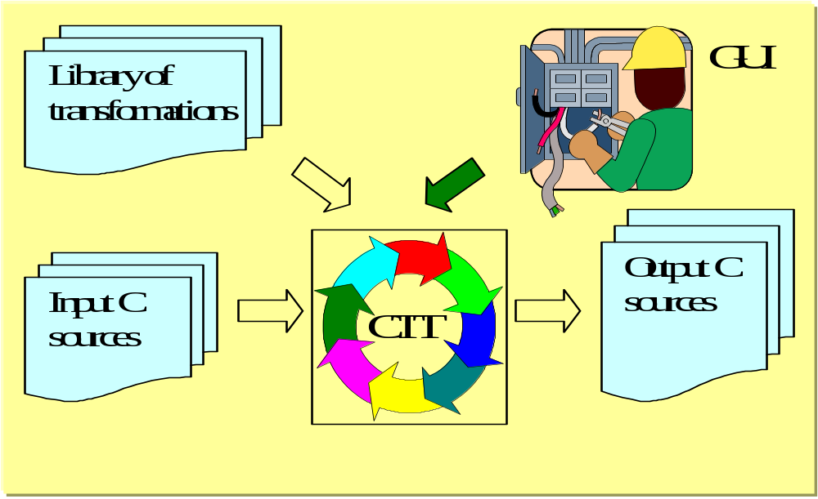
Design transformations
Source-to-source transformations
CTT: code transformation tool

Slide 44
Transformation example: loop embedding
  ....
  for (i=0;i<100;i++){
  do_something();
  }....
  void do_something() {
  procedure body
  }
  ....
  do_something2();
  ....
  void do_something2() {
  int i;
  for (i=0;i<100;i++){
  procedure body
  }}

Slide 45
Structure of transformation
  PATTERN {
  description of the code selection stage
  }
  CONDITIONS {
  additional constraints
  }
  RESULT {
  description of the new code
  }

Slide 46
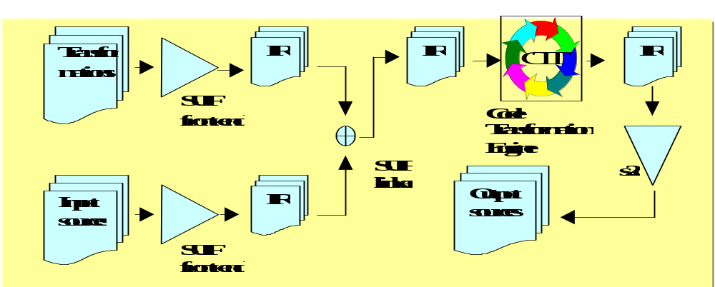
Implementation

Slide 47
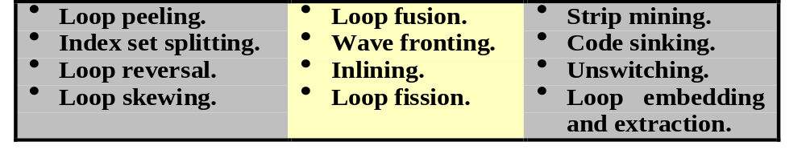
Experimental results
Could transform 39 out of 45 SIMD loops (in a set of 9 DSP benchmarks and MPEG)
Can handle transformations like:

Slide 48
Partitioning your program for Multiprocessor single chip solutions

Slide 49
Multiprocessor embedded system
RAM
RAM
Asip1
Asip2
Asip3
core
core
core
sfu3
sfu1
sfu2
sfu1
sfu1
sfu2
RAM
I/O
TPU
An ASIP based heterogeneous multiprocessor
  How to partition and map your application?
  Splitting threads

Slide 50
Design transformations
Why splitting threads?
Combine fine (ILP) and coarse grain parallelism
Avoid ILP bottleneck
Multiprocessor solution may be cheaper
  More efficient resource use
Wire delay problem → clustering needed !

Slide 51
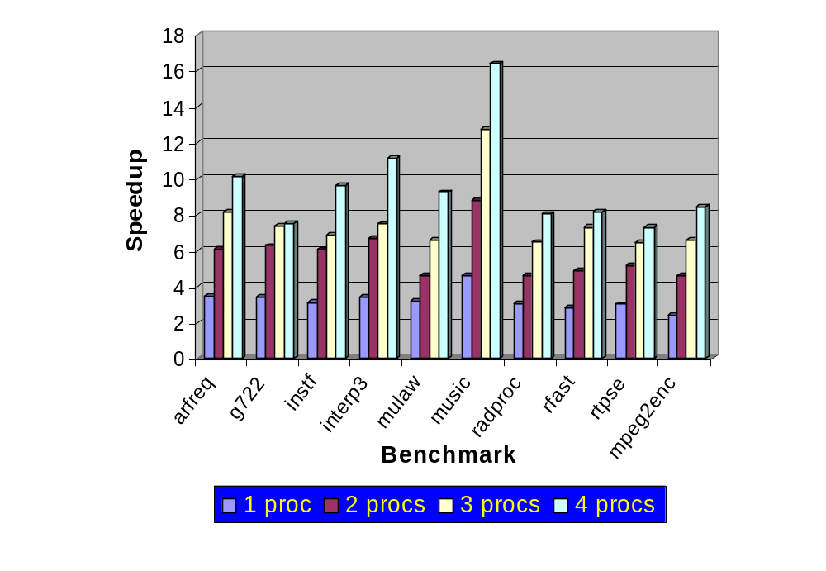
Experimental results of partitioner

Slide 52
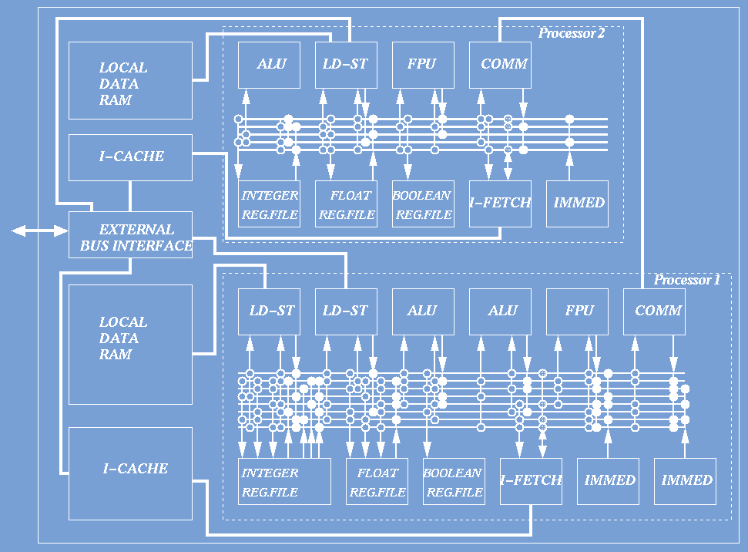
Instant frequency tracking example

Slide 53
Global program optimizations

Slide 54
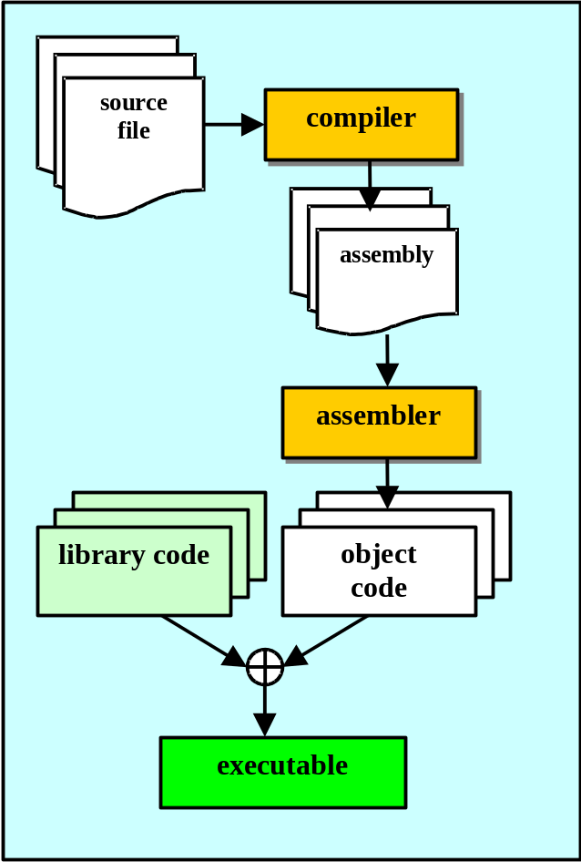
Traditional compilation path
Compiler output is textual, i.e. assembly
  loss of source-level information.
The object code defines the program’s memory layout.
  efficient binary representation, but
  not suitable for code transformations.

Slide 55
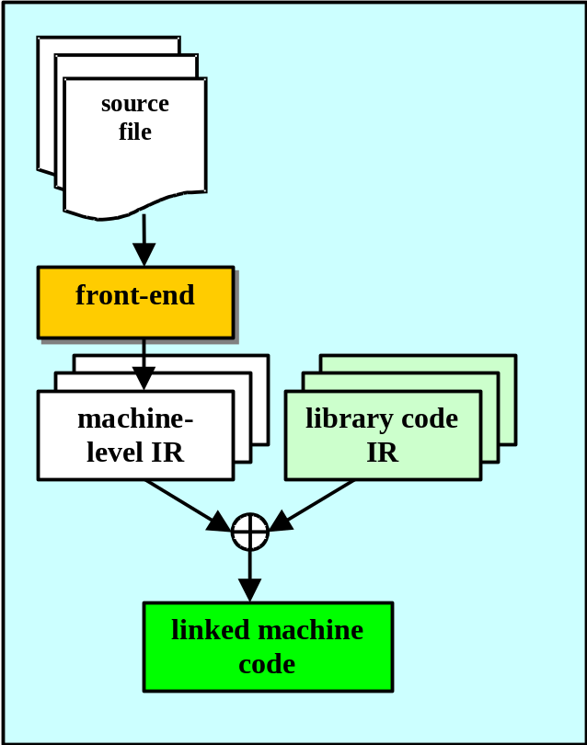
New Compilation Path
Structured machine-level representation of the program:
  the representation is accessible to “binary tools”,
  high-level information is maintained and passed to the linker,
  code transformations on whole-programs are easier.
The link function and the section offsets information must be rethought.

Slide 56
Inter-module Register Allocation
After linkage global exported variables can be allocated to registers
  Performing re-allocation of exported variables before scheduling is expensive
Solution: re-allocation after linking all modules
Analyses on variable aliasing (is address taken?) is computed and maintained
A larger pool of live ranges candidates available for actual register allocation

Slide 57

Fixed-point conversion: motivation
Cost of floating-point hardware.
Most “embedded” programs written in ANSI C.
C does not support fixed-point arithmetic.
Manual writing of fixed-point programs is tedious and error-prone (insertion of scaling operations).
Fixed-point extensions to C are only a partial solution.

Slide 58
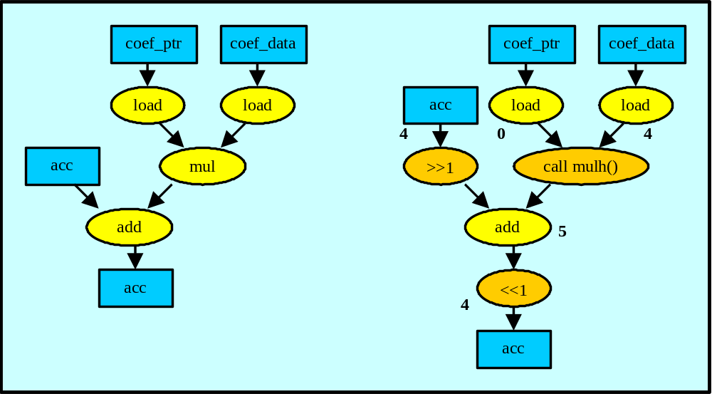
Fixed-point conversion
Example:
acc += (*coef_ptr) * (*data_ptr)

Slide 59
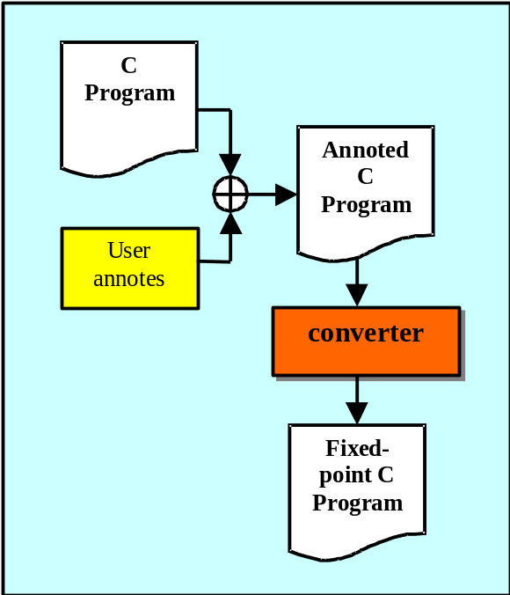
Methodology
The user starts with a floating-point version of the application.
The user annotates a selected set of FP variables.
The converter automatically converts the remaining variables/temporaries and delivers feedback.
Result: source file where floating-point variables are replaced by integer variables with appropriate scaling operations.

Slide 60
Link-time code conversion
Problem: linking fixed-point code with library code
  transformations on binary code impractical
  source-level linkage is awkward
Solution: Floating- to fixed-point conversion of library code “on the fly” during linkage.
Advantages:
  No need to compile in advance a specific version of the library for a particular fixed-point format.
  Information about the fixed-point format can flow between user and library code in both directions.

Slide 61
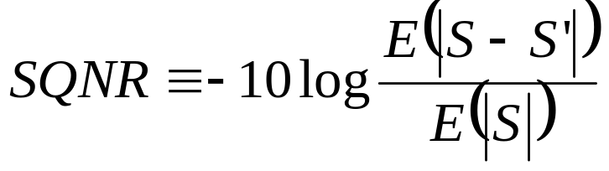
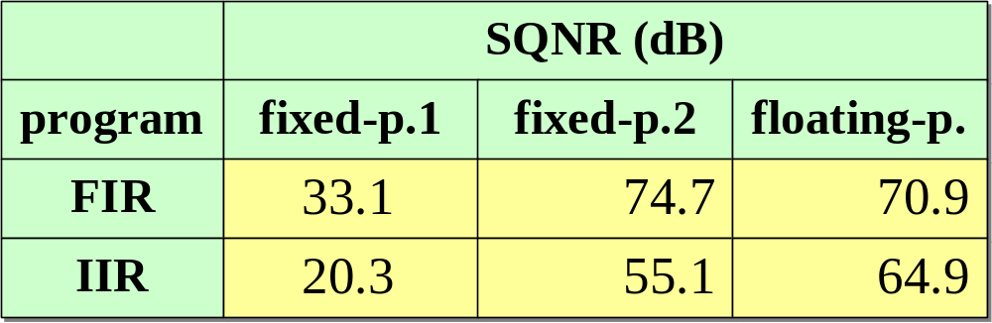
Experimental Results
Test programs: 35th-order FIR, 6th-order IIR filters
Accuracy Metric: signal-to-noise ratio (dB)
S = floating-point signal
S’ = fixed-point signal

Slide 62
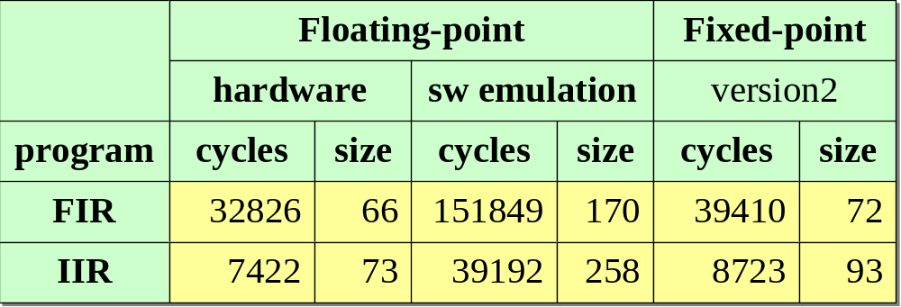
Experimental Results
Performance and code size

Slide 63
What next?
How to map your application A(L,A,D) to hardware (L,N,C)
L: design level (e.g. architecture, implementation or realization level)
A: application compononents
D: dependences between application components
N: hardware component
C: connections between hardware components

Slide 64
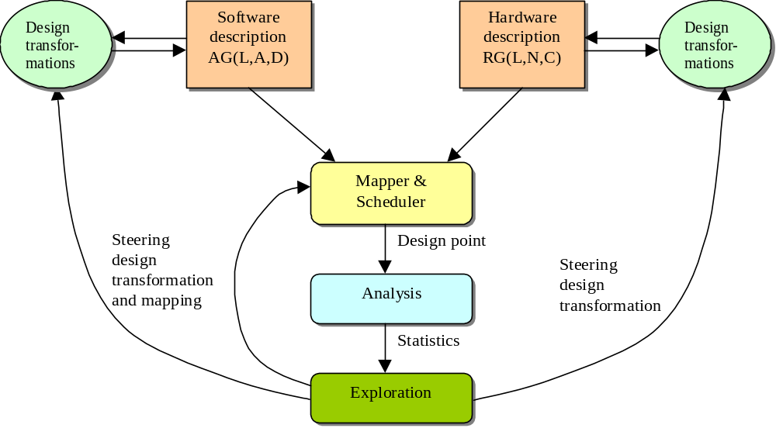
Integrated design environment
In the MOVE project we mostly ‘closed’ the right part of the design cycle !!

Slide 65
Conclusions / Discussion
Billions of embedded systems with embedded processors sold annually; how to design these systems quickly, cheap, correct, low power,.... ?
We have experience with tuning architectures for applications
  extremely flexible templated TTA; used by several companies
  parametric code generation
  automatic TTA design space exploration
The challenge: automated tuning of applications for architectures : closing the Y-chart
  design transformation framework needed

